Slide 1

MODULE 10
Nutrient Management and Soil Health in Urban/Small Scale Agricultural Systems

Slide 2
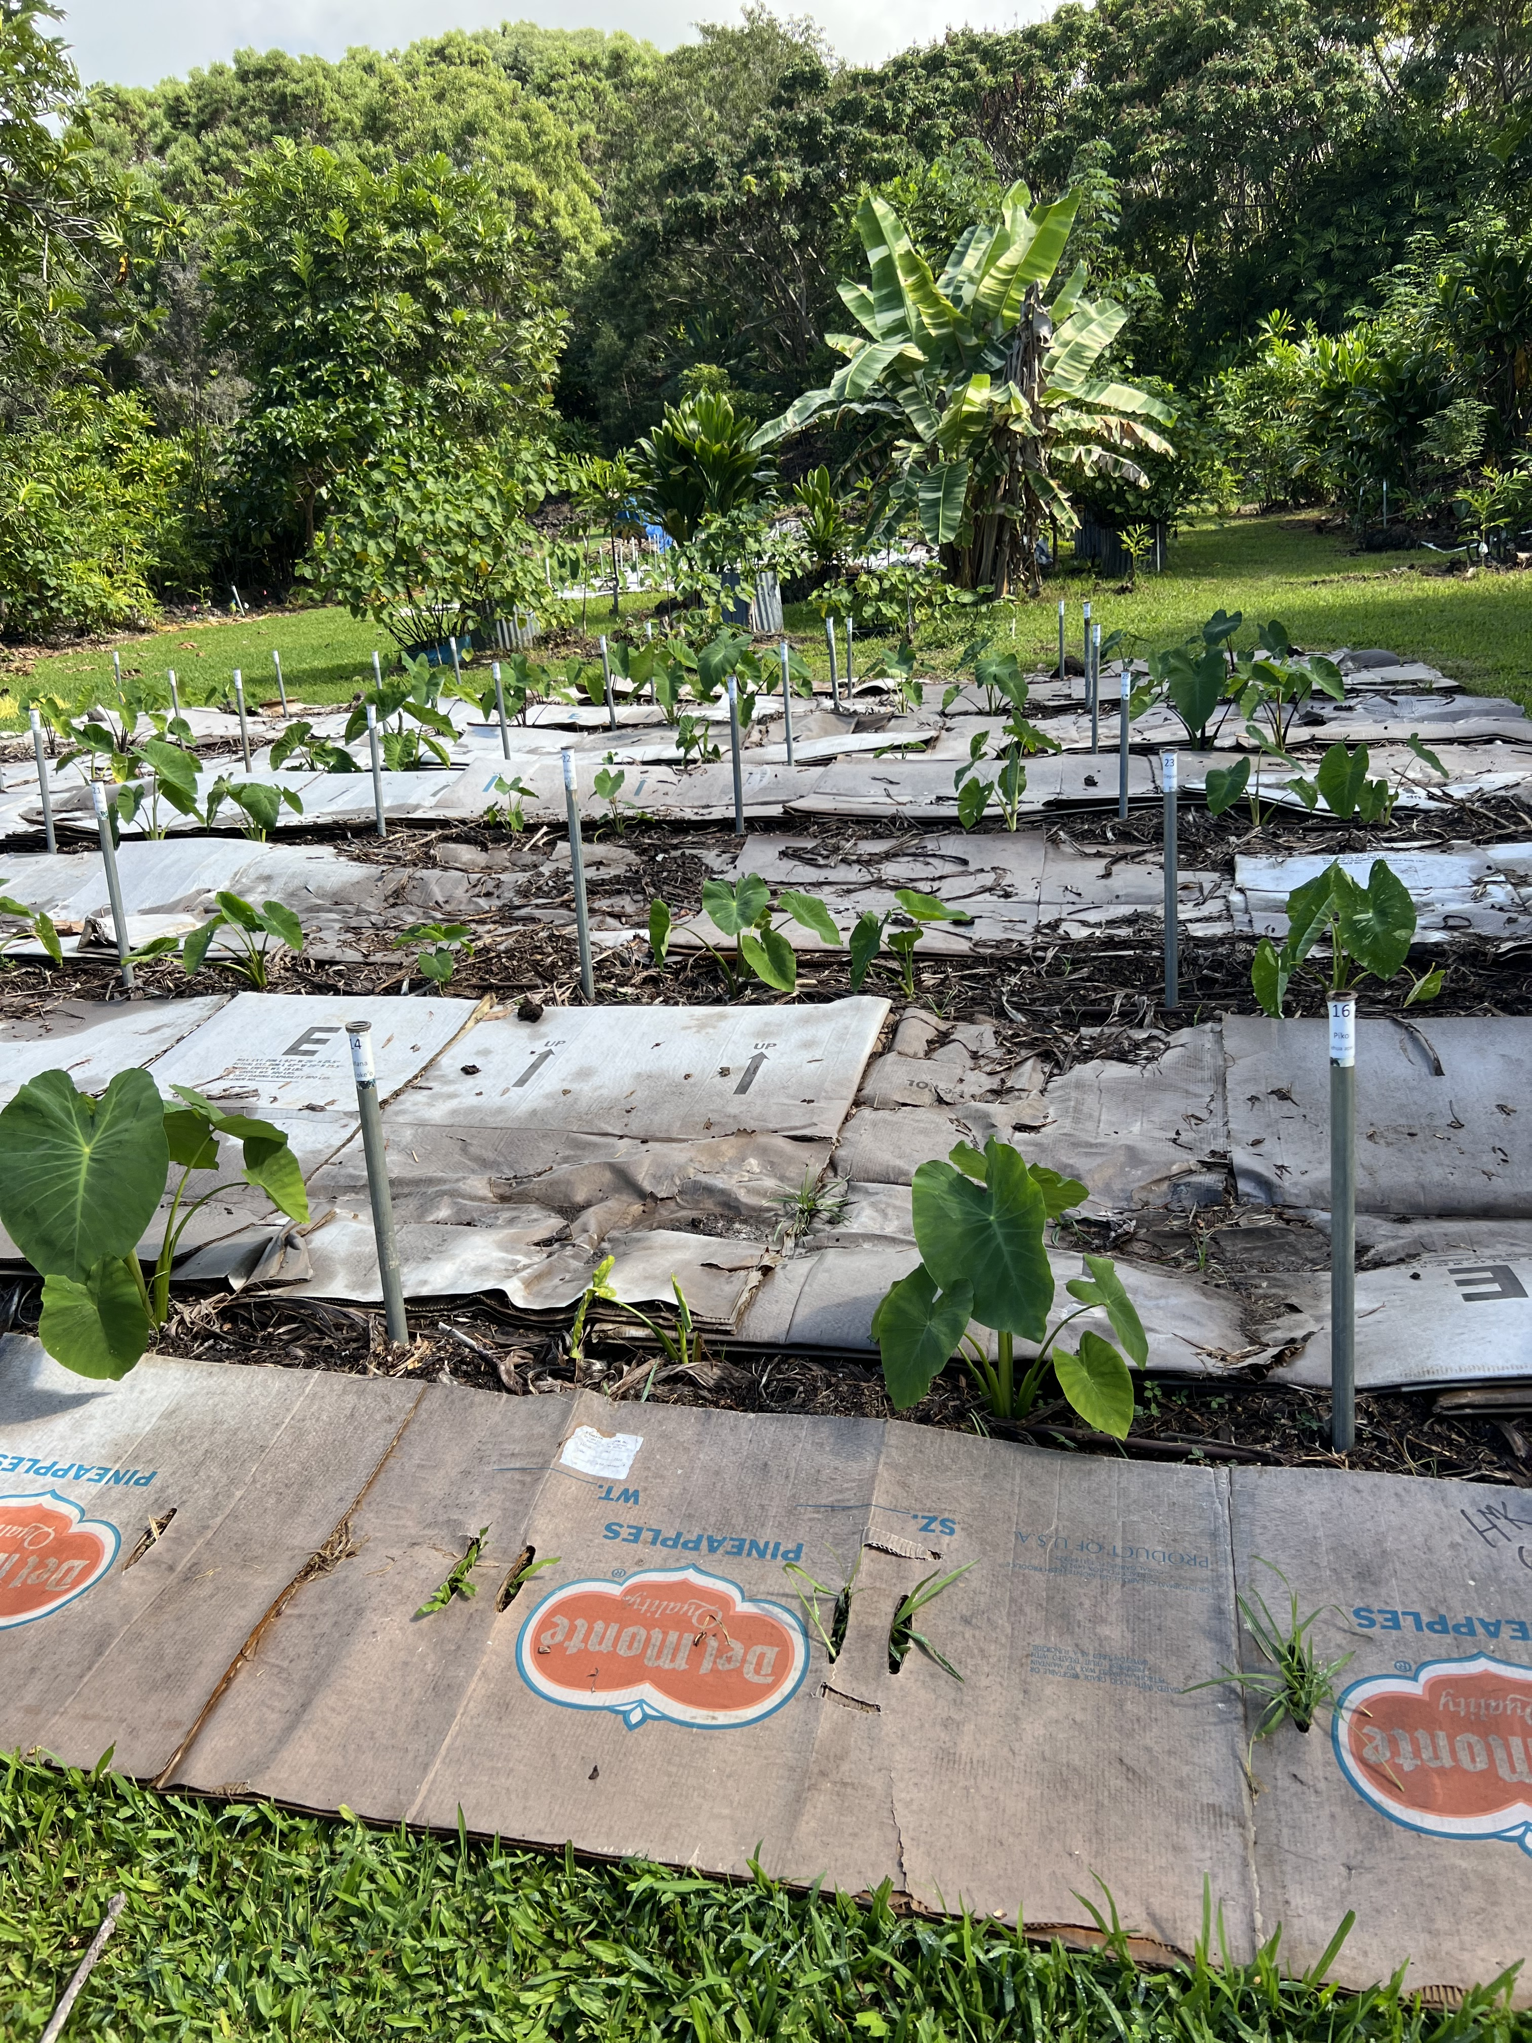
Objectives
To introduce role of soil fertility and pH to SH.
Explore some common nutrient sources in small scale systems.
Explore available nutrient management resources and tools.

Slide 3
Soil Health – Human Health Analogy
Human Health |  | Soil Health
Given Physical Attributes |  | Inherent Soil Properties
Weight, Blood Pressure |  | Soil Health Indicators
Blood Test |  | Soil Fertility Test
Notes:
Human health and soil health are comparable in that they are very complex systems and their “health” is the summation of many different aspects.
Given human attributes – height, genetic predispositions etc. Given soil attributes – soil texture, depth to bedrock, etc.
Ask what makes humans healthy. How does this compare to soil? Another way to think about it – How well is the system working?
A blood test is similar to a fertility test. A runner could be generally healthy but have a iron deficiency. A soil could have great health in one way but be deficient in a particular nutrient. Conversely, a soil could have poor health but have no fertility issues. Fertility is an important part of soil health.

Slide 4

Why is soil fertility important to soil health?
Soil Cover - Maximize plant growth through sufficient nutrients
Maximize living roots - Encourages healthy root growth
Minimize disturbance – Minimizes chemical disturbance
Maximize diversity – Increases diversity by not over/under applying nutrients and managing for optimal pH

Slide 5
Soil Health
Soil Fertility
Soil fertility is a critical component of soil health. It is a Goldilocks consideration – it should be just right.
Notes:
Soil fertility is a critical component to soil health.
Going back to our example of the runner – if they ignore their iron deficiency, it will eventually impact other aspects of their health.
Soil health and fertility tests are different but both important to addressing the overall health of the soil.

Slide 6
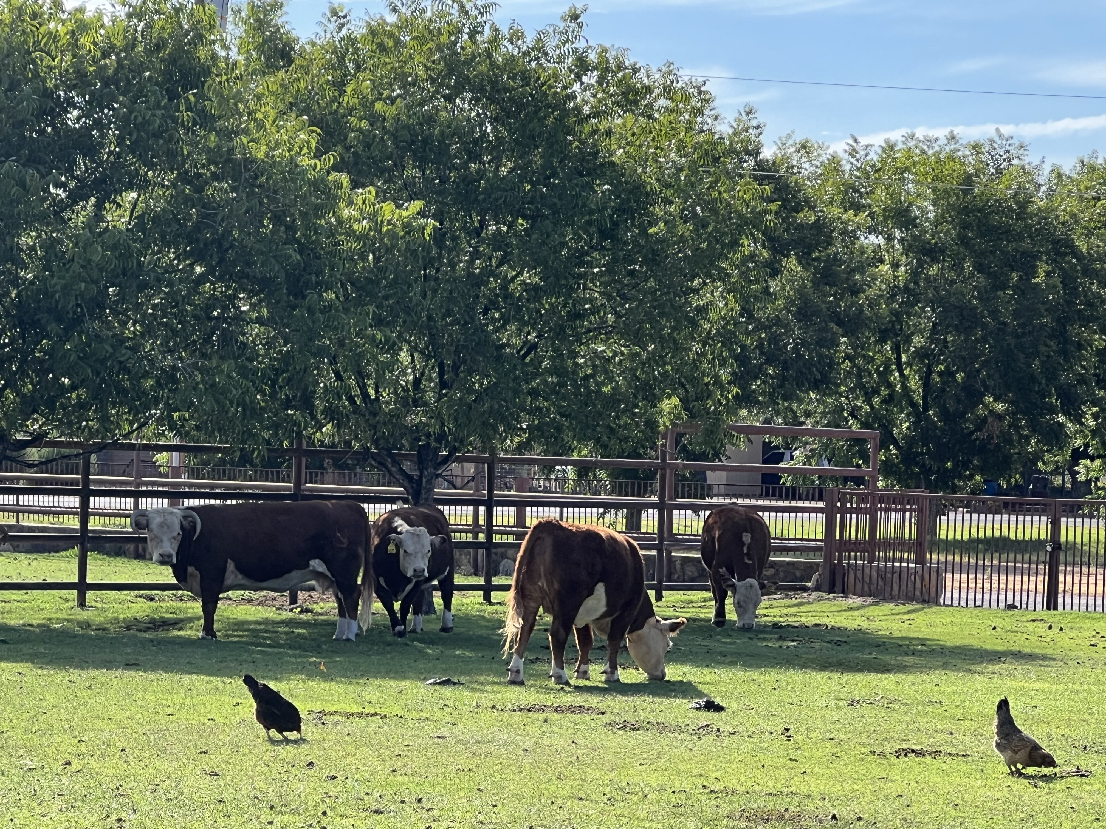
4 R’s of Nutrient Management
Right Source
Right Rate
Right Time
Right Place
Applies to all nutrient sources
Notes:
Is everyone familiar with the 4’Rs?
Each of the R’s is equally important and applies to inorganic and organic sources of fertility.

Slide 7
What are common sources of fertility in small scale farms in your area?
Soil Fertility

Slide 8
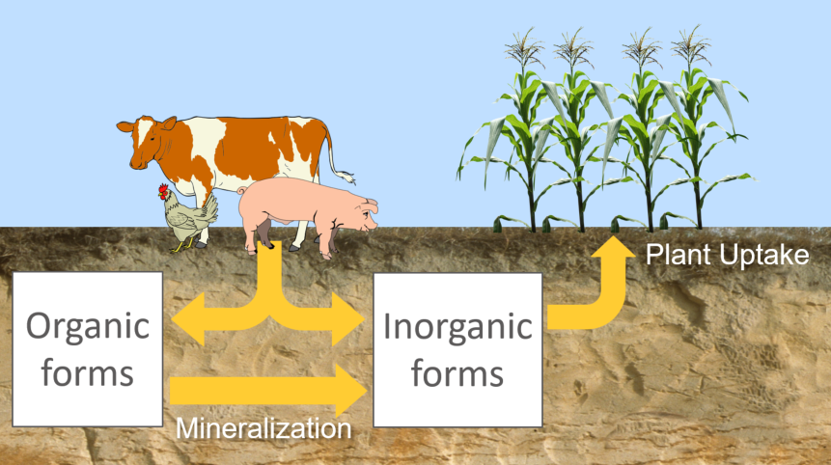
Inorganic and Organic Fertilizers
Organic sources can have variable N-P-K
Some sources may provide more P than needed when trying to meet N requirements
Soil temperature, pH, and moisture can affect availability
Fig: University of Minnesota
Notes:
What are some difference between organic and inorganic sources of fertility?
Availability – we rely on organisms to decompose the organic sources
Source of C included in the application. How would these differences impact the management of the system?

Slide 9
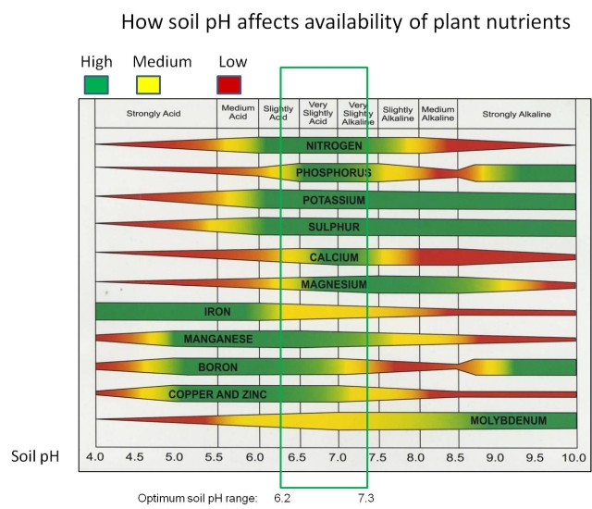
Nutrient Availability and pH
Optimal pH makes the nutrients in the soil more available for plant uptake
In general, soil microbes prefer neutral pH
Notes:
Explain the figure and highlight how the changing pH impacts the availability of the nutrients. Connect this to how pH can affect plant and soil organism growth due to nutrient limitations. Some plants (blue berries, cranberries ect.) are adapted to various pH and should be managed based on their preferences, however other plants are tolerant (meaning they do not experience a growth limitation in a given pH range).

Slide 10
Common N and P Loss Pathways
In general:
N is lost as a gas or dissolved in water
P is lost as a sediment bound particle or dissolved in water
Over application leads to increased risk of loss
Organic materials can be light and at risk of loss from wind and water
Surface applications of nutrients can be at greater risk of loss from erosion
Field Condition | Leaching | Volatilization | Surface
Sloped | N |  | N and P
Flat | N |  | P (where there is erosion)
Drained/Fast Draining Soils | N and P
Saturated | N | N | P
Very Dry |  | N (after N application)
Notes:
Ask participants what conditions they have experienced in their areas.
Discuss what pathways might be common in small scale situations such as raised beds, and high tunnels. Discuss how inorganic and organic sources might differ – inorganic is generally more water soluble; some organic sources are light and might be more mobile on the surface if not incorporated.

Slide 11
Key Takeaways
Consider the characteristics of the fertilizer
  Nutrient availability
  N-P-K balance
Consider the application site
  Crop needs/complexity
  Soil
  Timing
  Risk of runoff or leaching
  Sensitivity of surrounding area

Slide 12
How does this apply in small scale/urban environments? What are some of the considerations?
Back to 4 R’s of Nutrient Management
Consider the characteristics of the fertilizer
  Nutrient availability
  N-P-K balance
Consider the application site
  Crop needs/complexity
  Soil
  Timing
  Risk of runoff or leaching
  Sensitivity of surrounding area
Notes:
Discuss how nutrient management differs in small scale/urban environments. Write a list on a white board.

Slide 13
Example Nutrient Concentrations in Fertilizers
Fertility Source | N (%) | P (%) | K (%) | Availability
Compost | 1-3 | 1-2 | 1-2 | moderate
Blood Meal | 12 | 1-2 | 0-1 | fast
Poultry Manure | 3-4 | 1-2 | 1-2 | fast
Cattle Manure | 2-3 | 0.5-1 | 1-2 | moderate
Leaves | 1 | 0.5-1 | 0.5-1 | slow
Common Garden Fertilizer: Miracle Grow Fertilizer ™ | 24 | 8 | 16 | moderate – very fast
Urea | 46 | 0 | 0 | very fast
Diammonium phosphate (DAP) | 18 | 46 | 0 | very fast
Adapted from Purdue University Cooperative Extension Service and Nutrient and Manure Management Tables, University of Minnesota Extension
Notes:
Discuss how the N-P-K and availability might impact management. Refer back to the issues of overapplying P to achieve required N. Discuss common sources of fertility in your area.

Slide 14
Example Nutrient Concentrations in Fertilizers
Fertility Source | N (%) | P (%) | K (%) | Availability
Compost | 1-3 | 1-2 | 1-2 | moderate
Blood Meal | 12 | 1-2 | 0-1 | fast
Poultry Manure | 3-4 | 1-2 | 1-2 | fast
Cattle Manure | 2-3 | 0.5-1 | 1-2 | moderate
Leaves | 1 | 0.5-1 | 0.5-1 | slow
Common Garden Fertilizer: Miracle Grow Fertilizer ™ | 24 | 8 | 16 | moderate – very fast
Urea | 46 | 0 | 0 | very fast
Diammonium phosphate (DAP) | 18 | 46 | 0 | very fast
Other Considerations:
Micronutrients
Market availability
Cost
Ease of use
Timing
Risk of loss
Pest and/or beneficial organisms
Adapted from Purdue University Cooperative Extension Service and Nutrient and Manure Management Tables, University of Minnesota Extension
Notes:
Discuss how the N-P-K and availability might impact management. Refer back to the issues of overapplying P to achieve required N. Discuss common sources of fertility in your area.

Slide 15
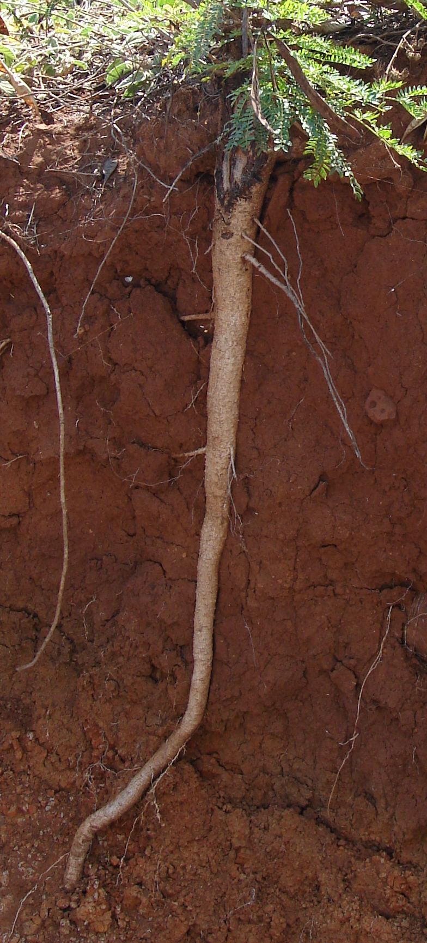
Practices that Impact Nutrient Management and Soil Health
CPS 333 – Amending Soil Properties with Gypsum Products
CPS 328 – Conservation Crop Rotation
CPS 336 – Soil Carbon Amendment
CPS 340 – Cover Crops
CPS 590 – Nutrient Management
Many others? Let’s discuss!
Notes:
How can we use our practices to improve nutrient management? Discuss how these practices affect nutrient management:
333 – adjust soil pH to increase availability of nutrients in the soil
328 – Some crops are better than other at using (or providing) nutrients in the soil. You can improve nutrient use efficiency by rotating crops from different functional groups – legumes, brassicas, and grass etc.
336 – Carbon amendments such as biochar can have a significant impact on soil pH. Increasing soil organic matter can increase the CEC of the soil and improve the nutrient holding/cycling potential.
340 – Cover crops can scavenge nutrients (or supply N) to the following crop depending on the cover crop species. Careful species selection can provide several nutrient benefits.
590 – Nutrient management helps use plan an efficient cropping system and tailor the inputs to the crop.

Slide 16
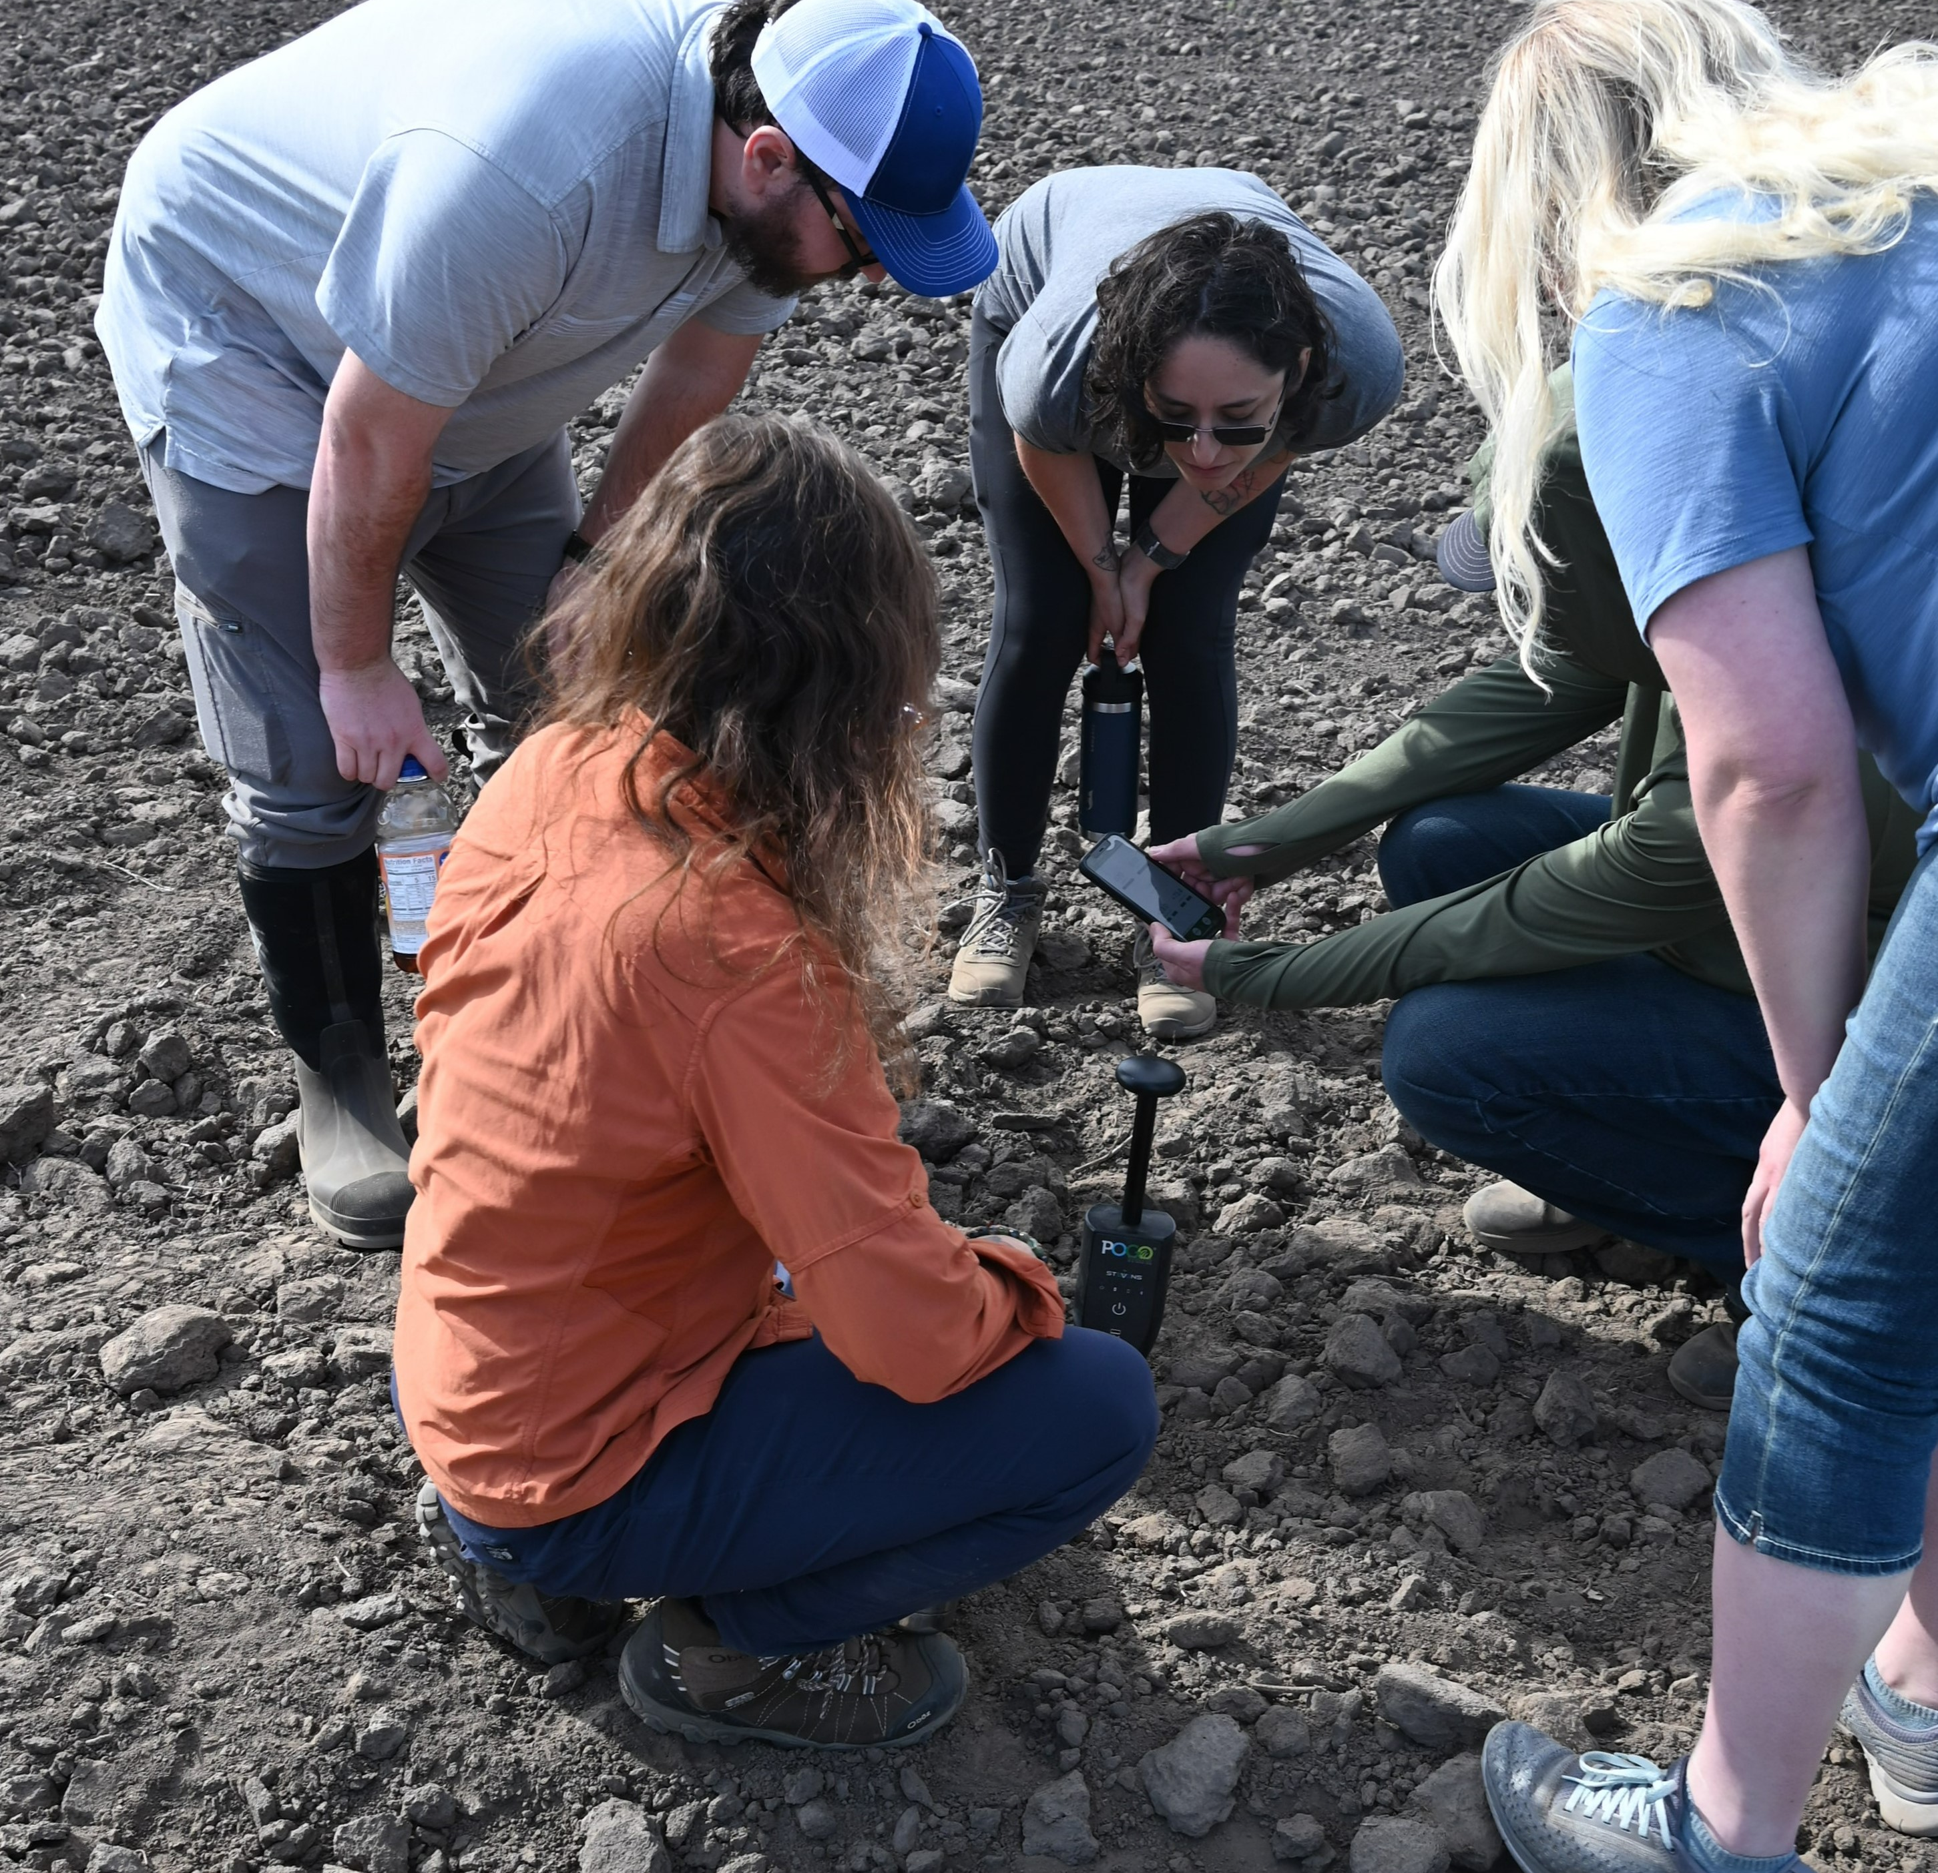
Soil Sampling and Testing
How do we monitor soil health and nutrient status in the soil?

Slide 17
Soil Health Monitoring Analogy
Human Health |  | Soil Health
Given Physical Attributes |  | Inherent Soil Properties
Weight, Blood Pressure |  | Soil Health Indicators
Blood Test |  | Soil Fertility Test
Notes:
Back to our analogy, how do the given physical attributes affect the potential health of the person? Do they have any limitations? Chose your favorite athlete to discuss inherent attributes vs. training and lived experience. What kind of measures would we use to measure the different aspects of human health?

Slide 18
Soil Health Monitoring Resources
Soil Health |  | Potential Resources
Inherent Soil Properties |  | Soil type and static characteristics from Web Soil Survey Texture Analysis
Soil Health Indicators |  | CEMA 216 Soil Health Testing
Soil Fertility Test |  | CEMA 217 Soil and Source Testing for Nutrient Management
Notes:
Discuss the different information and tests that are available.
Be clear that the only static properties may provide support for making recommendations for soil fertility and health.
Discuss useful information from WSS (drainage, soil type…) and considerations using WSS such as scale.
Discuss the “snapshot” nature of 216/217. Explain that fertility tests are used for fertility recommendations based on many decades of university trials. CEMA 216 is a monitoring tool to observe changes and trends in the soil.

Slide 19
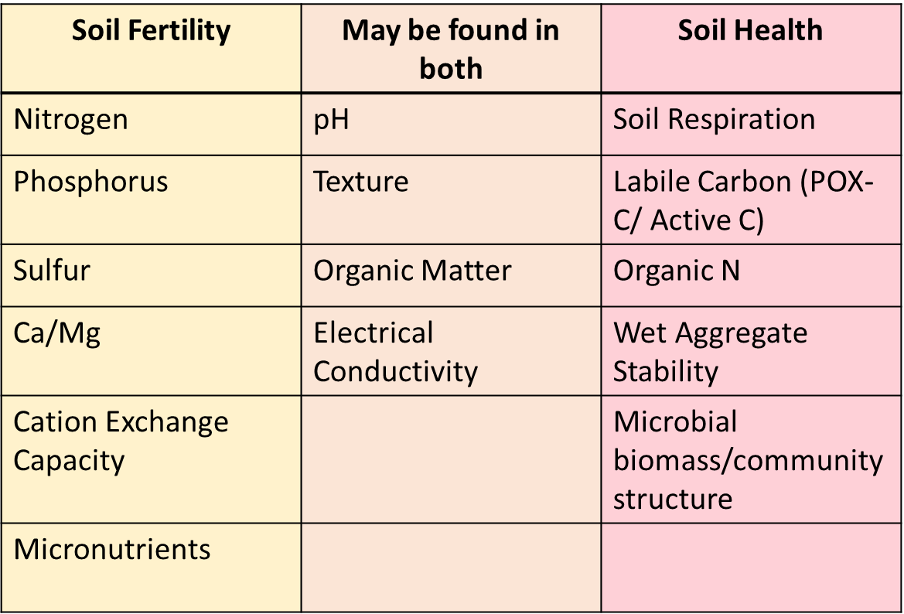
Common Components of Soil Fertility and Soil Health Lab Tests
Notes:
Here are some common measures that are included in soil health (216) and fertility (217) tests. Keep in mind that a fertility test is looking at nutrition – the availability of nutrients in the soil for organism growth, while soil health is looking at different aspects of the soil ecosystem. How is their environment and activity doing?

Slide 20
CEMA 216 and 217 Sampling Comparison
CEMA | Sampling Depth | Type of Sampling | Sampling Method | Recommended Frequency
CEMA 216 | 6-8 inches | Composite 1 sample per polygon | Soil slice with shovel preferred | Before and after a practice is implemented and/or every three years
CEMA 217 – Small Scale Scenario | Rooting depth (LGU guidance) | Composite 1 sample per 0.5 acres | LGU guidance | Every three years
CEMA 216 soil sampling is NOT adequate for fertility recommendations.
Sampling must be conducted by Qualified Individual (QI) or person under the guidance of QI.
Samples for 216 and 217 can be sent to the same laboratory if the required tests are offered, however soil storage and shipping may differ. Refer to laboratory for guidance.
Laboratories must be certified.
Notes:
Highlight how soil sampling for CEMAs 216 and 217 are different.

Slide 21
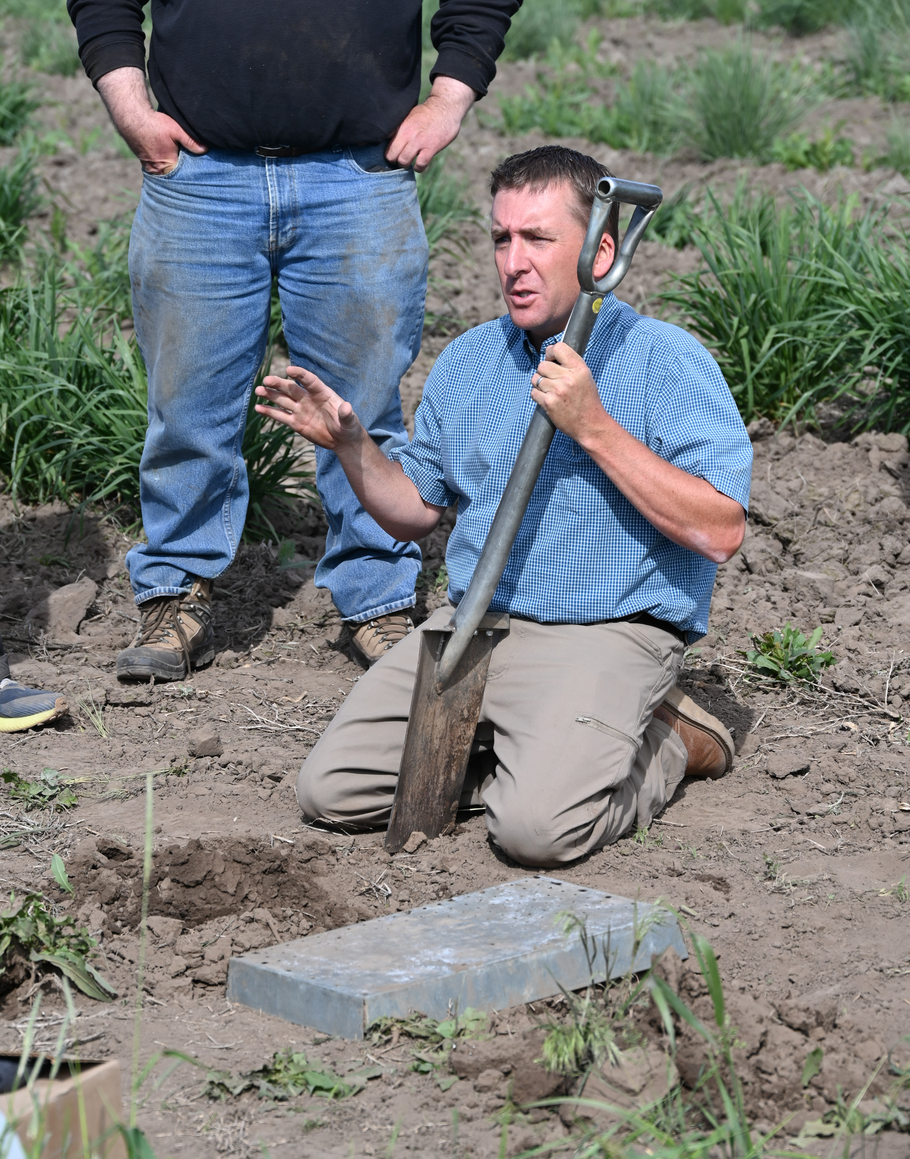
Soil Sampling in Urban Environments
Will the objectives be different?
How is it different from a larger scale system?
Let’s go to the field to learn and discuss!!

Slide 22

This information is provided as a public service and constitutes no endorsement by the United States Department of Agriculture or the Natural Resources Conservation Service of any service, supply, or equipment listed.
While an effort has been made to provide a complete and accurate listing of services, supplies, and equipment, omissions or other errors may occur and, therefore, other available sources of information should be consulted
The USDA is an equal opportunity provider and employer.
Meeh, NRCS

Slide 23
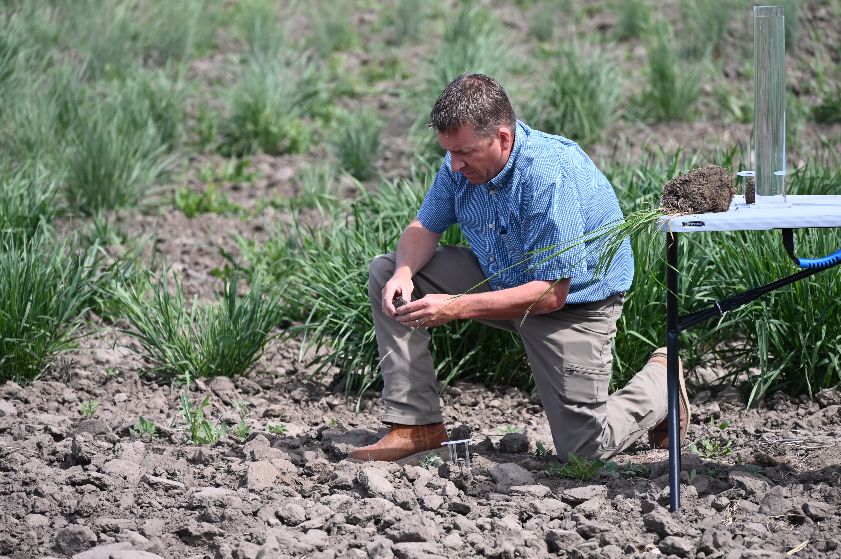
Nutrient Management Tools
Notes:
This slide can be used if there is a demo of nutrient management tools

